Slide 1
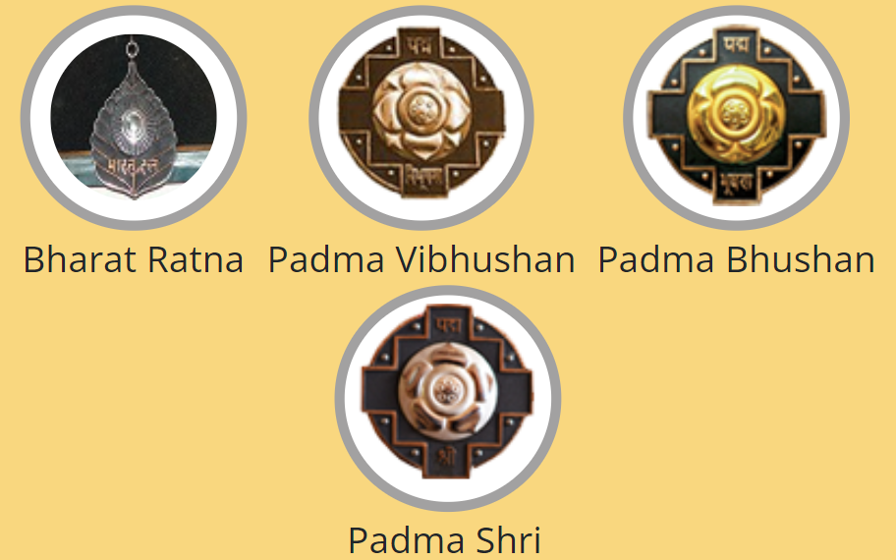
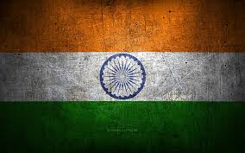
SL | Script | Media
1. | Welcome to our documentary on the prestigious civilian awards of India. These awards celebrate excellence and honor individuals who have made remarkable contributions to various fields, shaping the nation's progress and inspiring generations

Slide 2
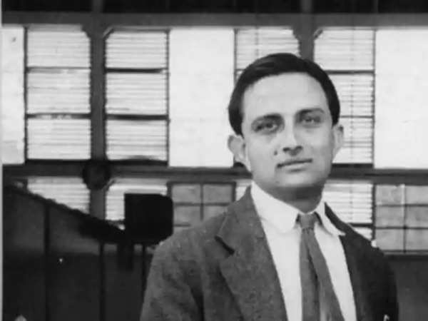
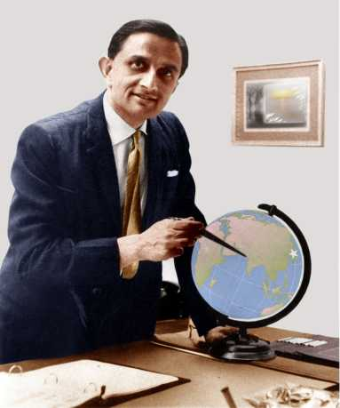
2. | Our focus today is on one of India's most revered scientists and visionaries, Dr. Vikram Ambalal Sarabhai. His journey is not just about personal achievements but also about how one man's dedication can ignite a revolution in science and technology.

Slide 3
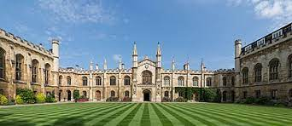

3. | Born on August 12, 1919, in Ahmedabad, Gujarat, Dr. Sarabhai showed exceptional intelligence and curiosity from a young age. His academic journey led him to Cambridge University, where he pursued his higher studies in science and engineering.

Slide 4

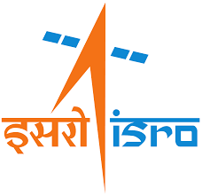
4. | Dr. Sarabhai's contributions to space research are monumental. He laid the foundation for India's space program and played a pivotal role in establishing the Indian Space Research Organization (ISRO) in 1969.

Slide 5
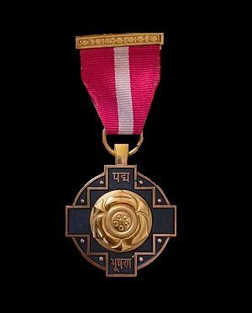
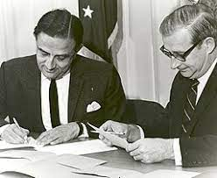
5. | His visionary leadership and scientific acumen earned him numerous awards, including the Padma Bhushan in 1966 for his contributions to science and engineering.

Slide 6
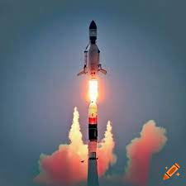
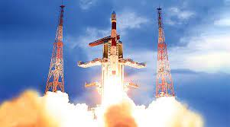
6. | Under Dr. Sarabhai's guidance, ISRO achieved remarkable milestones like launching India's first satellite, Aryabhata, and embarking on ambitious missions like Chandrayaan, showcasing India's prowess in space exploration.

Slide 7
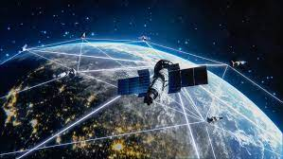

7. | Beyond his scientific achievements, Dr. Sarabhai believed in using technology for societal development. He pioneered satellite communication and weather forecasting systems, revolutionizing communication and disaster management.

Slide 8


8. | Like any journey of innovation, Dr. Sarabhai faced challenges and setbacks. Failures in rocket launches and budget constraints tested his resilience and determination.

Slide 9

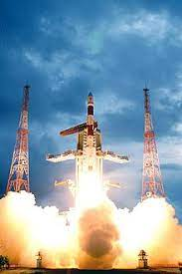
9. | However, Dr. Sarabhai's resilience and leadership were unparalleled. He motivated his team, learned from failures, and strategized better approaches, leading to groundbreaking successes.

Slide 10
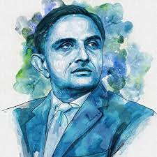

10. | Today, Dr. Vikram Ambalal Sarabhai's legacy lives on, inspiring generations of scientists, engineers, and dreamers to push boundaries, think beyond limits, and strive for excellence.

Slide 11
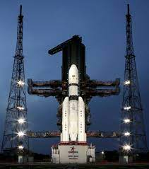
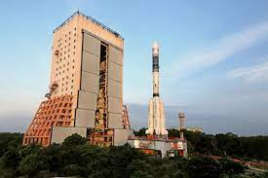


11. | In conclusion, Dr. Vikram Ambalal Sarabhai's contributions to Indian science and technology, his visionary leadership at ISRO, and his impact on society make him a true pioneer and a recipient of India's highest civilian honors.

Slide 12

12. | We extend our gratitude to all the sources and individuals who contributed to this documentary, helping us share the inspiring story of Dr. Vikram Ambalal Sarabhai and India's civilian awards.

Slide 13



13. | For further reading and exploration, here are some references and resources that delve deeper into Dr. Sarabhai's life, achievements, and contributions.

Slide 14
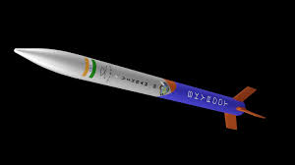

14. | Thank you for joining us on this enlightening journey through the life and legacy of Dr. Vikram Ambalal Sarabhai, a true visionary and a beacon of inspiration for generations to come.

